Slide 1
21CS2213RA AI for Data Science Session -3
Contents: Solving problems by searching

Slide 2
Session Outcomes
Students will learn about problem solving agents.
Students will learn precise definitions of various types of problems and their solutions .

Slide 3
Reflex Agents:
The simplest agents like Vacuum cleaner agent we discussed is an example of Reflex Agents.
These agent base their actions on a direct mapping from states to actions.
Such agents cannot operate well in environments for which this mapping would be too large to store and would take too long to learn.

Slide 4
Problem Solving Agents:
Goal-based agents, on the other hand, consider future actions and the desirability of their outcomes.
Some of these goal-based agent are called problem-solving agents.
Problem-solving agents use atomic representations called states of the world which are considered as wholes, with no internal structure visible to the problem solving algorithms.
Planning Agents:
Goal-based agents that use more advanced factored or structured representations are usually called planning agent.

Slide 5
Problem-Solving Agent:
Intelligent agents are supposed to maximize their performance measure in solving problems. Various steps in solving problem are:
Goal formulation, based on the current situation and the agent's performance measure, is the first step in problem solving.
Problem formulation is the process of deciding what actions and states to consider, given a goal.
The process of looking for a sequence of actions that reaches the goal is called search. A search algorithm takes a problem as input and returns a solution in the form of an action sequence.
Once a solution is found, the actions it recommends can be carried out. This is called the execution phase.

Slide 6
We first describe the process of problem formulation, and then algorithms for the SEARCH function.
Well-defined problems and solutions : A problem can be defined formally by five components:
The initial state that the agent starts in.
A description of the possible actions available to the agent Given a particular state s, called ACTIONS(s), returns the set of actions that can be executed in s.
A description of what each action does; the formal name for this is the transition Model.
The goal test, which determines whether a given state is a goal state.

Slide 7
A path cost function that assigns a numeric cost to each path. The problem-solving agent chooses a cost function that reflects its own performance measure.
The step cost of taking action a in state s to reach state s1 and denoted by C(s, a, s1).

Slide 8
EXAMPLE PROBLEMS :
Toy Problems(intended to illustrate or exercise various problem-solving methods)
Vacuum Cleaner
8-Puzzle Problem
8-Queens Problem
Real-World Problems(whose solutions people actually care about)
Route Finding Problem
Travelling Salesperson Problem
Robot Navigation

Slide 9
1. Vacuum cleaner Example(Toy problem)
Initial state: Any state can be designated as the initial state.
Actions: Left, Right, and Suck
Transition model: The complete state space is shown in the next slide.
Goal test: This checks whether all the squares are clean.
Path cost: Each step costs 1, so the path cost is the number of steps in the path.
The state is determined by both the agent location and the dirt locations.
The agent is in one of two locations, each of which might or might not contain dirt. Thus, there are 2 × 2² = 8 possible world states. A larger environment with n locations has n x 2^{n} states.

Slide 10
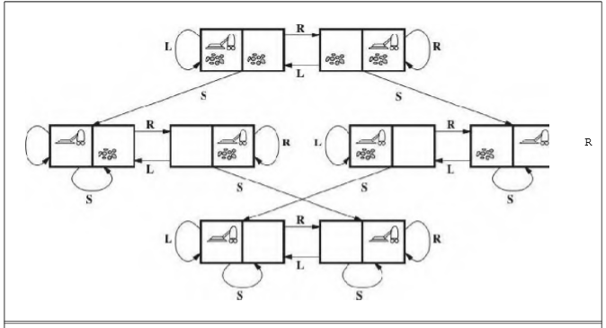

Slide 11
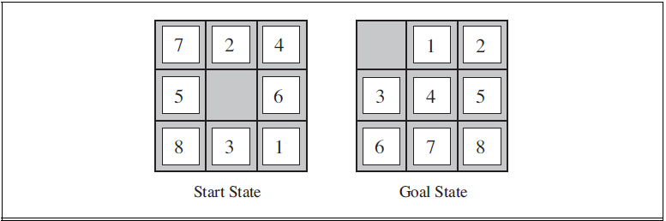

2. 8-puzzle problem (Toy problem)
The 8-puzzle belongs to the family of sliding-block puzzles, which are often used as test problems for new search algorithms in AI.

Slide 12
Initial state: Any state can be designated as the initial state. Note that any given goal can be reached from exactly half of the possible initial states.
Actions: The simplest formulation defines the actions as movements of the blank space. Left, Right, Up, or Down. Different subsets of these are possible depending on where the blank is.
Transition model: Given a state and action, this returns the resulting state; for example, if we apply Left to the start state in the above figure the resulting state has the 5 and the blank switched.
Goal test: This checks whether the state matches the goal configuration shown in Figure
• Path cost: Each step costs 1, so the path cost is the number of steps in the path.
States: A state description specifies the location of each of the eight tiles and the blank in one of the nine squares.

Slide 13

3. 4-queens problem (Toy Problem)
The 4-Queens Problem consists in placing four queens on a 4 x 4 chessboard so that no two queens can capture each other. That is, no two queens are allowed to be placed on the same row, the same column or the same diagonal (non-attacking).
We can generalize it to nXn chessboards with n>=4.

Slide 14
Initial state: No queens on the board.
Actions: Add a queen to any empty square.
Transition model: Returns the board with a queen added to the specified square.
Goal test: 8 queens are on the board, none attacked.
States: Any arrangement of 0 to 4 queens on the board is a state.

Slide 15
1. Route-Finding Problem (Real-world Problem)
Consider the airline travel problems that must be solved by a travel-planning Web site:
Initial state: This is specified by the user’s query.
Actions: Take any flight from the current location, in any seat class, leaving after the current time, leaving enough time for within-airport transfer if needed.
Transition model: The state resulting from taking a flight will have the flight’s destination as the current location and the flight’s arrival time as the current time.
Goal test: Are we at the final destination specified by the user?
Path cost: This depends on monetary cost, waiting time, flight time, customs and immigration procedures, seat quality, time of day, type of airplane, frequent-flyer mileage awards, and so on.

Slide 16
States: Each state obviously includes a location (e.g., an airport) and the current time.
Furthermore, because the cost of an action (a flight segment) may depend on previous segments, their fare bases, and their status as domestic or international, the state must record extra information about these “historical” aspects.
Eg: Finding route in the following Romania map.
Initial state: currently in Arad. In(Bucharest),Visit(Bucharest)
Action: Drive between cities.
Transition model: The state resulting from taking a flight will have the flight’s destination as the current location and the flight’s arrival time as the current time. Eg: in(Fagaras), Visited(Arad,Sibiu,Fagaras)
Goal State: Be in Bucharest.
Path cost: monetary cost, waiting time, flight time, customs and immigration procedures etc.
States: various cities visited

Slide 17
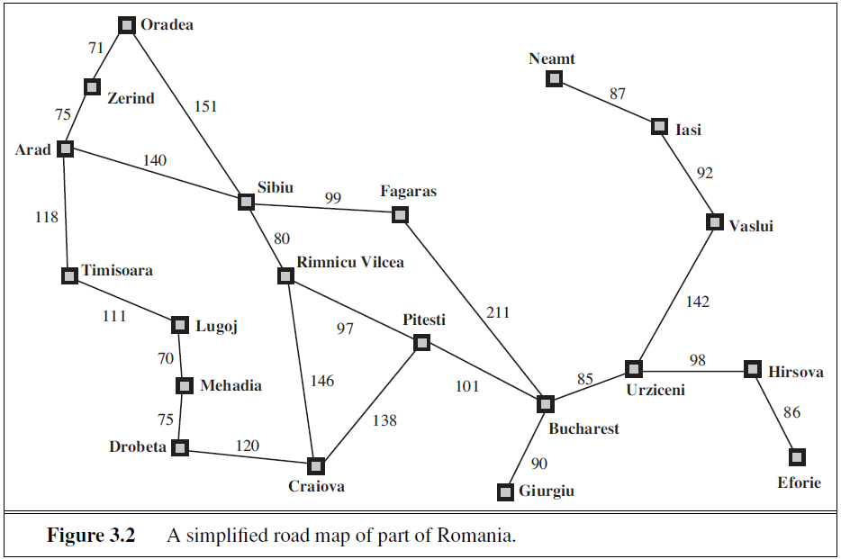

Slide 18
2. The Traveling Salesperson Problem (TSP)
(Real-world Problem)
TSP is a touring problem in which each city must be visited exactly once.
The aim is to find the shortest tour.
An enormous amount of effort has been expended to improve the capabilities of TSP algorithms.
In addition to planning trips for traveling salespersons, these algorithms have been used for tasks such as planning movements of automatic circuit-board drills and of stocking machines on shop floors.

Slide 19
3. Robot Navigation(Real-world problem)
Robot navigation is a generalization of the route-finding problem described earlier.
Rather than following a discrete set of routes, a robot can move in a continuous space with (in principle) an infinite set of possible actions and states.
For a circular robot moving on a flat surface, the space is essentially two-dimensional. When the robot has arms and legs or wheels that must also be controlled, the search space becomes many-dimensional.
Advanced techniques are required just to make the search space finite.

Slide 20
SEARCHING FOR SOLUTIONS
Having formulated some problems, we now need to solve them.
A solution is an action sequence, so search algorithms work by considering various action sequences. This can be implemented using search tree.
SEARCH TREE: The possible action sequences starting at the initial state form a search tree with the initial state at the root; the branches are actions and the nodes correspond to states in the state space of the problem.
The following figure shows the few steps in constructing the search tree for finding a route from Arad to Bucharest in the Romania map.

Slide 21
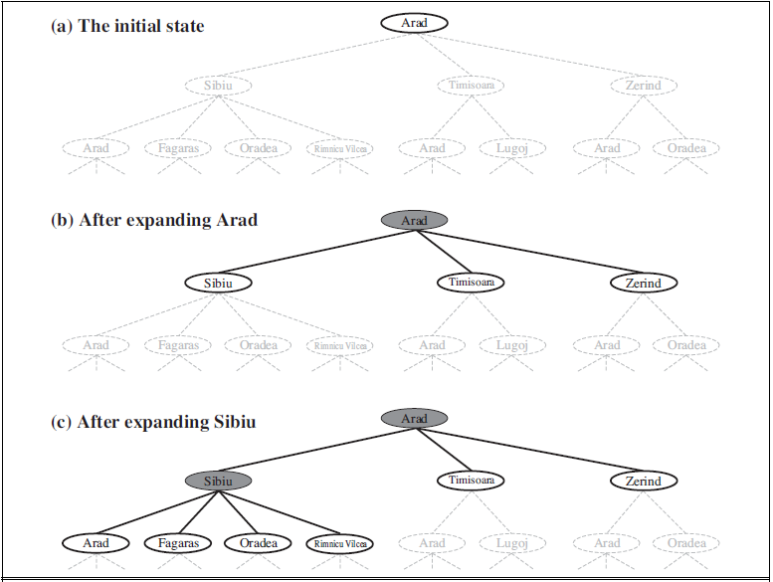
Partial search trees for finding a route from Arad to Bucharest. Nodes that have been expanded are shaded; nodes that have been generated but not yet expanded are outlined in bold; nodes that have not yet been generated are shown in faint dashed lines.

Slide 22
Terminology:
FRONTIER: A set of all the leaf nodes available for expansion at any given point. Generally, it is considered as open list.
EXPLORED SET: A set of nodes that are already explored. Generally the data structure is known as Close List.
GRAPH-SEARCH Algorithm: An algorithm used to find the solution.
TREE-SEARCH Algorithm: Uses a particular search strategy to choose which state to explore next.

Slide 23
Infrastructure for search algorithms
Search algorithms require a data structure to keep track of the search tree that is being constructed. For each node n of the tree, we have a structure that contains four Components:
n.STATE: The state in the state space to which the node corresponds.
n.PARENT: The node in the search tree that generated this node.
n.Action: The action that was applied to the parent to generate the node.
n.PATH-COST: The cost, traditionally denoted by g(n), of the path from the initial state to the node, as indicated by the parent pointers.

Slide 24
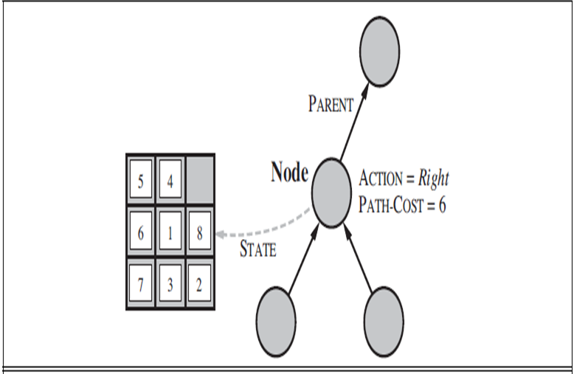
Nodes are the data structures from which the search tree is constructed. Each has a parent, a state, and various bookkeeping fields_ Arrows point from child to parent.

Slide 25
Measuring problem-solving performance
We can evaluate an algorithm's performance in four ways:
Completeness: Is the algorithm guaranteed to find a solution when there is one?
Optimality: Does the strategy find the optimal solution
Time complexity: How long does it take to find a solution?
Space complexity: How much memory is needed to perform the search?
End of Session

Slide 26
Thank you

